Slide 1
Database Management System

Slide 2
Contents
Schedules
Serial Schedules
Non-serial Schedules
Conflicting Operations
Concurrency
Serializability
Serializable Schedules
Conflict Serializabilty
View Serializability

Slide 3
Schedule
A series of operation from one transaction to another transaction is known as schedule. It is used to preserve the order of the operation in each of the individual transaction.
In other words we can say that a chronological execution sequence of a transaction is called a schedule.
When there are multiple transactions that are running in a concurrent manner and the order of operation is needed to be set so that the operations do not overlap each other, Scheduling is brought into play and the transactions are timed accordingly.

Slide 4
Example of Schedule
T1 T2
R(X)
W(X)
R(Y)
R(Y)
R(X)
W(Y)
T1 T2
R(X)
R(Y)
W(X)
R(Y)
R(X)
W(Y)
S1
S2

Slide 5
Types of Schedule
On the basis of order of execution it may be of two types
Serial Schedule
Non-Serial Schedule
On the basis of recoverability it may be of four types:
Recoverable Schedules
Non-Recoverable Schedules
Cascadless Schedule
Strict Schedules
On the basis of serializability it may be of two types
Conflict Serializable Schedule
View Serializable Schedule

Slide 6
Serial Schedule
The serial schedule is a type of schedule where one transaction is executed completely before starting another transaction.
In the serial schedule, when the first transaction completes its cycle, then the next transaction is executed.
For the below example T1,T2 and T2,T1 are two serial schedules.
The possible combinations of execution are:-
R1W1R2W2 R2W2R1W1
R1R2W1W2 R1R2W2W1
R2R1W2W1 R2R1W1W2
T1 R1 W1
T2 R2 W2

Slide 7
Non-Serial Schedule
If interleaving of operations is allowed, then there will be non-serial schedule.
It contains many possible orders in which the system can execute the individual operations of the transactions.
Non-serial schedule also known as concurrent schedule.
The possible combinations of execution are:-
R1W1R2W2 R2W2R1W1
R1R2W1W2 R1R2W2W1
R2R1W2W1 R2R1W1W2
T1 R1 W1
T2 R2 W2

Slide 8
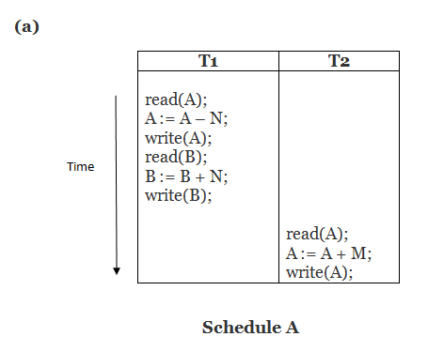
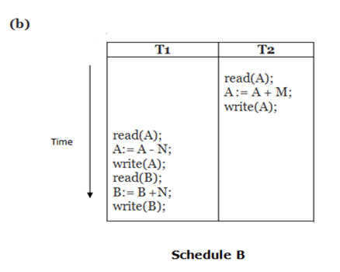
Find out the serial schedules and non-serial schedules?
Notes:
A and B both are serial schedule

Slide 9
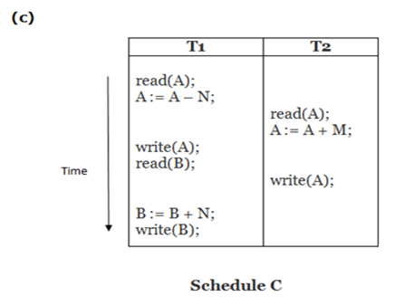
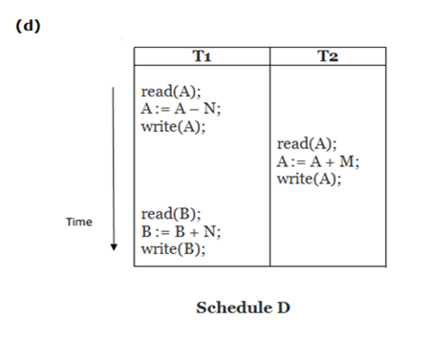
Continue…
Notes:
C and D both are non-serial schedule.

Slide 10
Advantages And disadvantages of serial schedule
Advantages :-
It always gives guarantee for data consistency.
Disadvantages:-
Limits Concurrency.
Causes CPU waste .
Low response time and low throughput could be possible.
Smaller transactions may need to wait long.

Slide 11
Advantages And disadvantages of non-serial schedule
Advantages:-
Reduce waiting time.
Improve response time and throughput.
Disadvantages:-
Possible data inconsistency.
Some time too much context switching.

Slide 12
Number of Possible schedules
If we have T1, T2, T3……Tm transaction and N1,N2,N3…..Nm operations respectively.
Then number of serial schedules will be m!
For example we have 2 Transaction T1 and T2 then the number of serial schedules will be 2!=2.
T1,T2 and T2, T1
For example we have 3 Transaction T1, T2 and T3 then the number of serial schedules will be 3!=6
T1,T2,T3
T1,T3,T2
T2,T1,T3
T2,T3,T1
T3,T1,T2
T3,T2,T1

Slide 13
Continue…
Total number of schedules will be:
(N1+N2+N3+…..+Nm)!/(N1!*N2!*N3!*……*Nm!)
Now we can calculate the non serial schedules. It will be:
Total number of schedules –number of serial schedules;
for the below example total number of schedules:= (2+2)!/2!*2! = 4!/4 =6
Number of serial schedules will be :- m! = 2!= 2
Number of non-serial schedules will be :- 6 – 2 = 4
T1 R1 W1
T2 R2 W2

Slide 14
Conflicting Operations
A pair of operations is said to be conflicting with each other if and only if they holds following three conditions:-
They must belong to different transactions
Both the operations are accessing the same data item.
At least one of the operation must be write operation.
For example we have the schedule:
S: r1(x) w2(x) r1(y) r2(y)

Slide 15
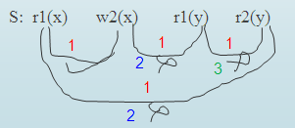
Continue…
So for the below example we find out only one conflicting operation which is r1(x) w2(x).
S: r1(x) w2(x) r1(y) r2(y)
Hence for any schedule only 3 type of conflicting operations are possible . They are:
R W
W R
W W

Slide 16
On the basis of recoverability schedule may be of four types:
Recoverable Schedules
Non-Recoverable Schedules
Cascadless Schedule
Strict Schedules

Slide 18
R1(x),R2(x),R1(z),R3(x),R3(y),W1(x),C1,W3(y),C3,R2(y),W2(z),W2(y),C2;
Strict Schedule
R1(x),R2(x),R1(z),R3(x),R3(y),W1(x),W3(y),R2(y),W2(z),W2(y),C1,C2,C3;
Not Recoverable Schedule
R1(x),R2(z),R3(x),R1(z),R2(y),R3(y),W1(x),C1,
W2(z),W3(y),W2(y),C3,C2;
Cascade-less Schedule

Slide 19
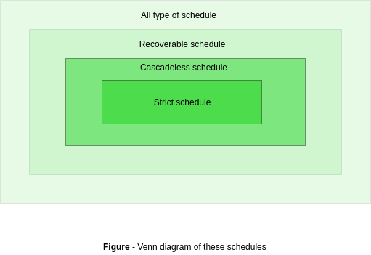
R1(x),W1(x),R2(x),R1(y),R2(y),W2(x),W1(y),A1,A2
Recoverable Schedule
R1(x),W1(x),R2(x),R1(y),W2(x),C2,A1;
Non Recoverable/irrecoverable/unrecoverable Schedule
R1(x),R2(x),W1(x),R1(y),W2(x),C2,W1(y),C1;
Cascade-less Schedule

Slide 22
Concurrency
Database concurrency is the ability of a database to allow multiple users to affect multiple transactions. This is one of the main properties that separates a database from other forms of data storage, like spreadsheets.
Concurrency Control in Database Management System is a procedure of managing simultaneous operations without conflicting with each other. It ensures that Database transactions are performed concurrently and accurately to produce correct results without violating data integrity of the respective Database.
Advantages of Concurrency:-
Reduced waiting time, response time or turn around time.
Increased throughput or resource utilization.
Disadvantages of Concurrency:-
When multiple transactions are executed concurrently than some times database may become inconsistent.
Interleaving of instruction between transactions may also lead to many problems due to which concurrency control is required.

Slide 23
Problems with concurrency
When multiple transactions execute concurrently in an uncontrolled or unrestricted manner, then it might lead to several problems. These problems are commonly referred to as concurrency problems in database environment.
The five concurrency problems that can occur in database are:
Temporary update problem
Lost update problem
Incorrect summary problem
Unrepeatable read problem
Phantom read problem

Slide 24
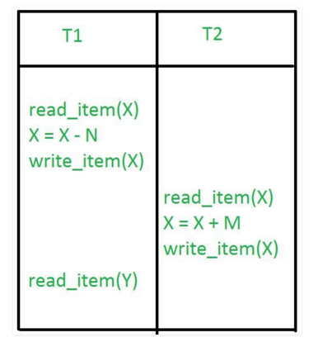
Temporary Update Problem
Temporary update occurs when one transaction updates a database item and then transaction fails for some reason. The updated database item is accessed by another transaction before it is changed back to the original value.
This problem is also known as dirty read problem.
Example is as follows:-
In the example, if transaction 1 fails for some reason then X will revert back to its previous value. But transaction 2 has already read the incorrect(uncommitted) value of X.

Slide 25
Lost Update Problem
In the lost update problem, update done to a database item by a transaction is lost as it is overwritten by the update done by another transaction.
In other words, if transactions T1 and T2 both read a record and then update it, the effects of the first update will be overwritten by the second update.
Example is as follows:-
In this example, transaction 1 changes the value of X but it gets overwritten by the update done by transaction 2 on X. Therefore, the update done by transaction 1 is lost.

Slide 26
Incorrect Summary Problem
When one of the transactions is checking on aggregate summary function while other transactions are updating then this problem is called incorrect summary problem.
Example is as follows:-
T1 | T2
Sum=0; Read_item(A); Sum=Sum+A; . . . Sum=Sum+P; . . . Sum=Sum+Z; AVG(); | read_item(P) P=P+100; write_item(P) C
In this example, transaction 1 reads the value of P but it gets overwritten by the update done by transaction 2 on P. Therefore, the access done by transaction 1 is incorrect for P data item.
Notes:
C stands for commit.

Slide 27
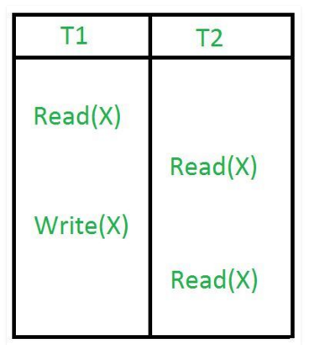
Unrepeatable Read
The unrepeatable read problem occurs when two or more read operations of the same transaction read different values for the same variable..
Unrepeatable read problem is also known as inconsistent retrievals problem.
Example is as follows:-
In this example, once transaction 2 reads the variable X, a write operation in transaction 1 changes the value of the variable X. Thus, when another read operation is performed by transaction 2, it reads the new value of X which was updated by transaction 1.

Slide 28
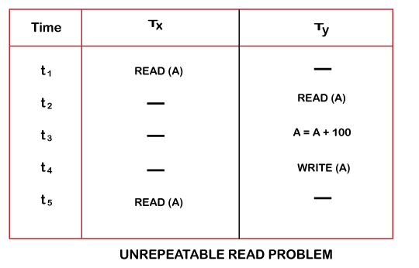

Slide 29
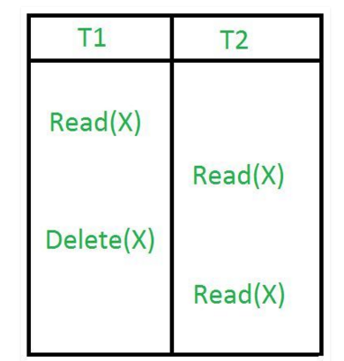
Phantom Read Problem
The phantom read problem occurs when a transaction reads a variable once but when it tries to read that same variable again, an error occurs saying that the variable does not exist.
Example is as follows:-
In this example, once transaction 2 reads the variable X, transaction 1 deletes the variable X without transaction 2’s knowledge. Thus, when transaction 2 tries to read X, it is not able to read it.

Slide 30
When two schedules are equivalent?
There are three types of equivalence of schedules :
Result equivalence
Conflict equivalence
View equivalence

Slide 31
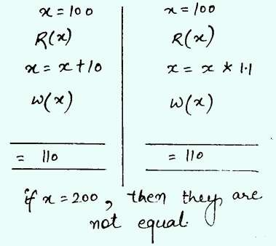
Result equivalence
In results equivalence, the end result of schedules heavily depends on input of schedules. The final values are calculated from both schedules and check whether they are equal or not.
Example is as follows:-
These two schedules are not result equivalence.

Slide 32
Continue…
One more example is as follows:-
S1
T1 | T2
R(x) x=x+10 W(x) C | R(x) x=x-7 W(x) C
S2
T1 | T2
R(x) x=x-5 W(x) C | R(x) x=x+8 W(x) C
When x=20 then output of s1 is 23. Similarly on x=20 output of s2 is 23.
When x=10 then output of s1 is 13. Similarly on x=10 output of s2 is 13. So these two schedules are result equivalence.

Slide 33
Thanks

